Slide 1
Theme: Minting with Unique Network Wallet
Presented by
SudharshanReddy Chennupalle

Slide 2
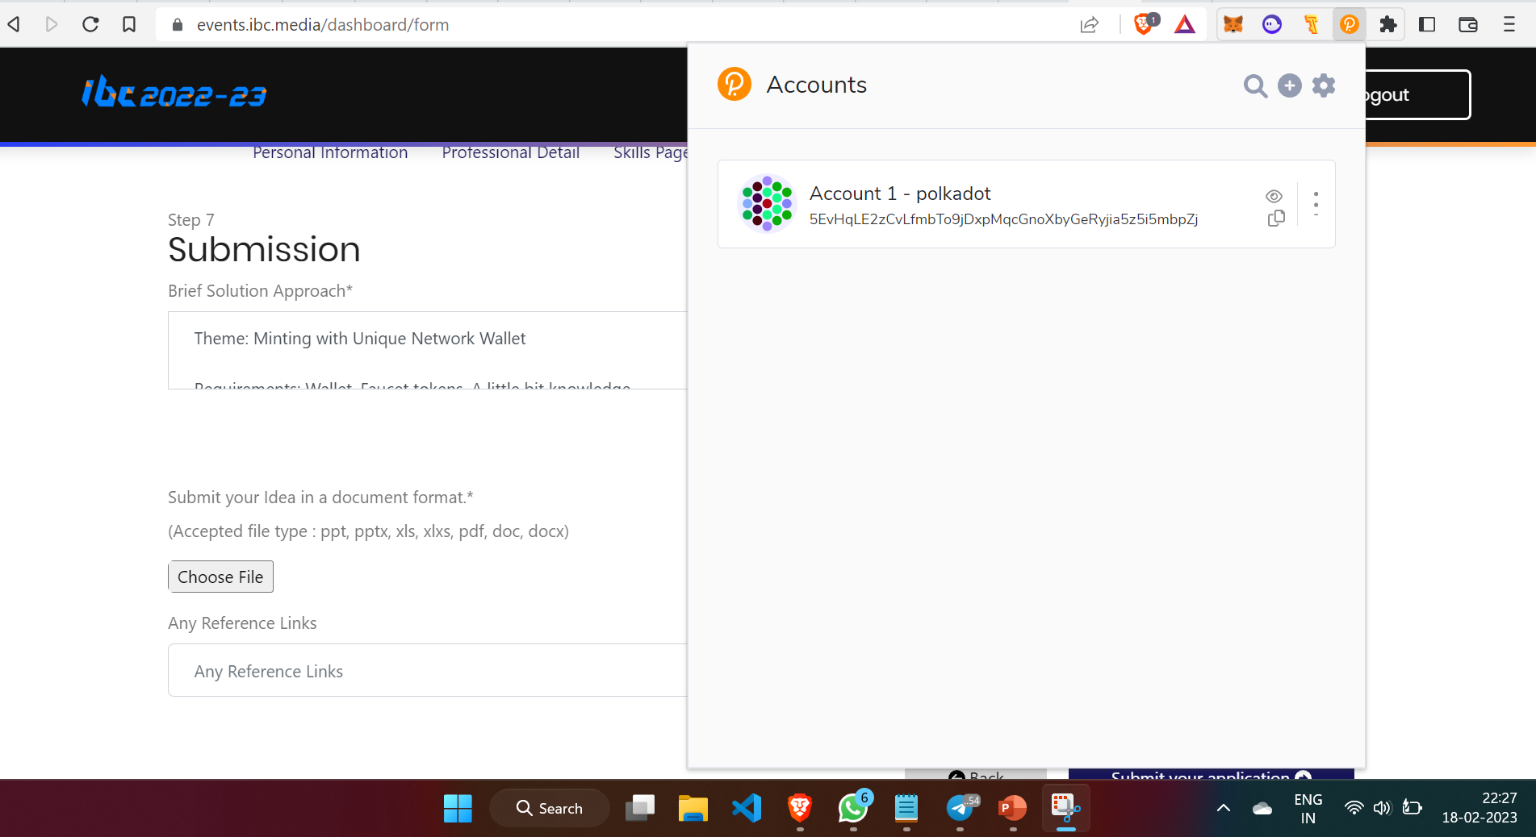
1. Adding Polkadot.js wallet extension to web browser

Slide 3
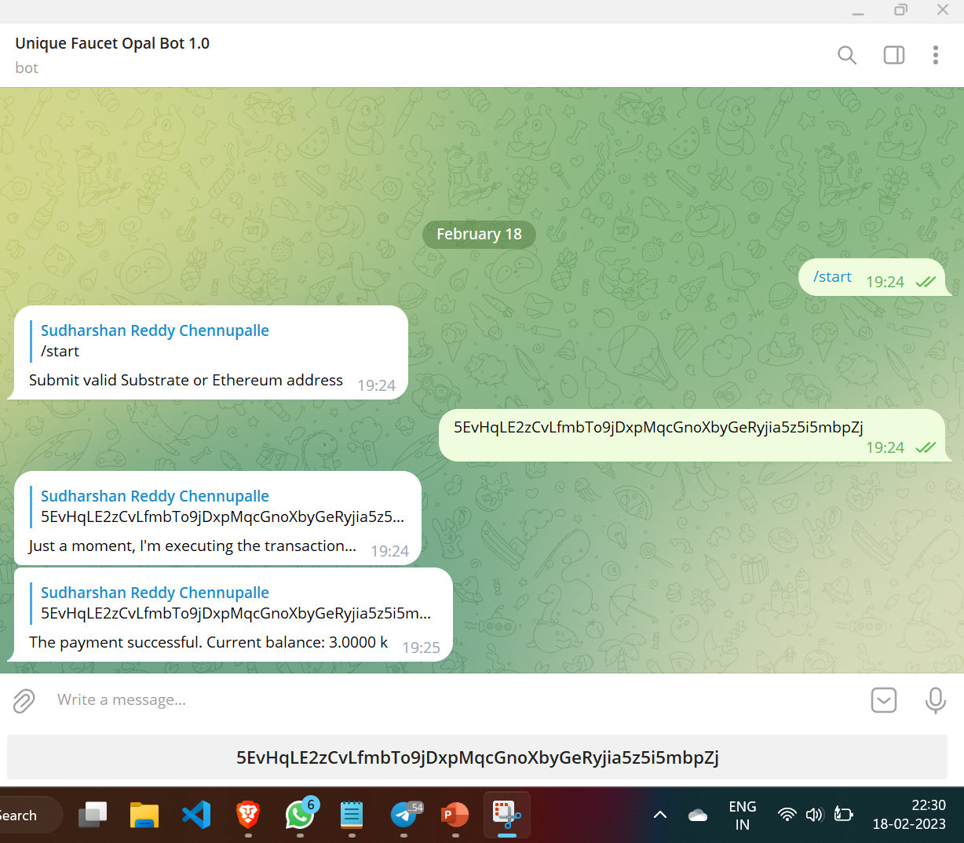
2. Requesting tokens from Unique Facet telegram bot

Slide 4
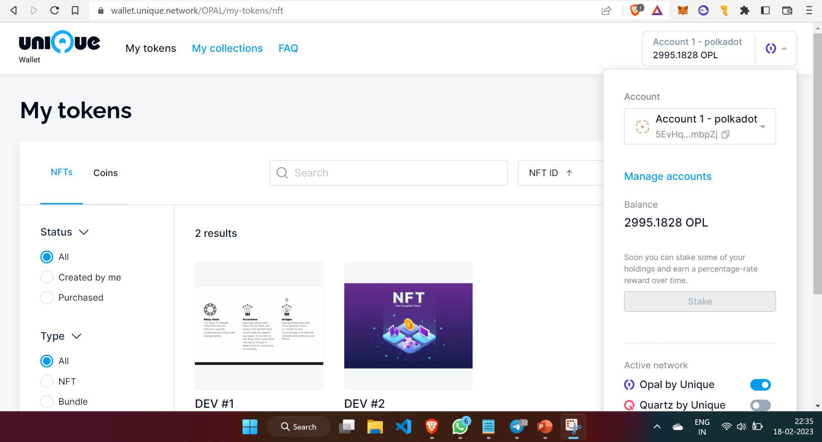
3. Connecting polkadot.js wallet with Unique Network

Slide 5
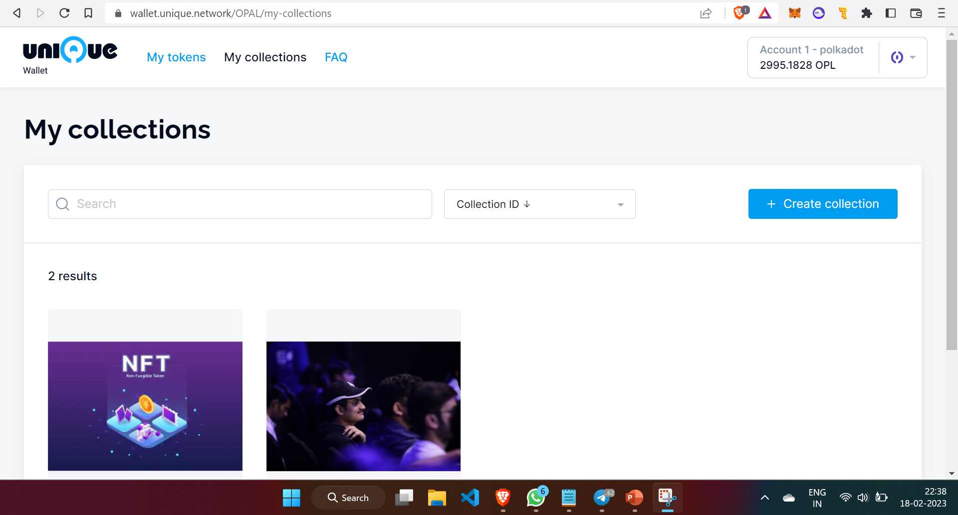
4. My collections

Slide 6
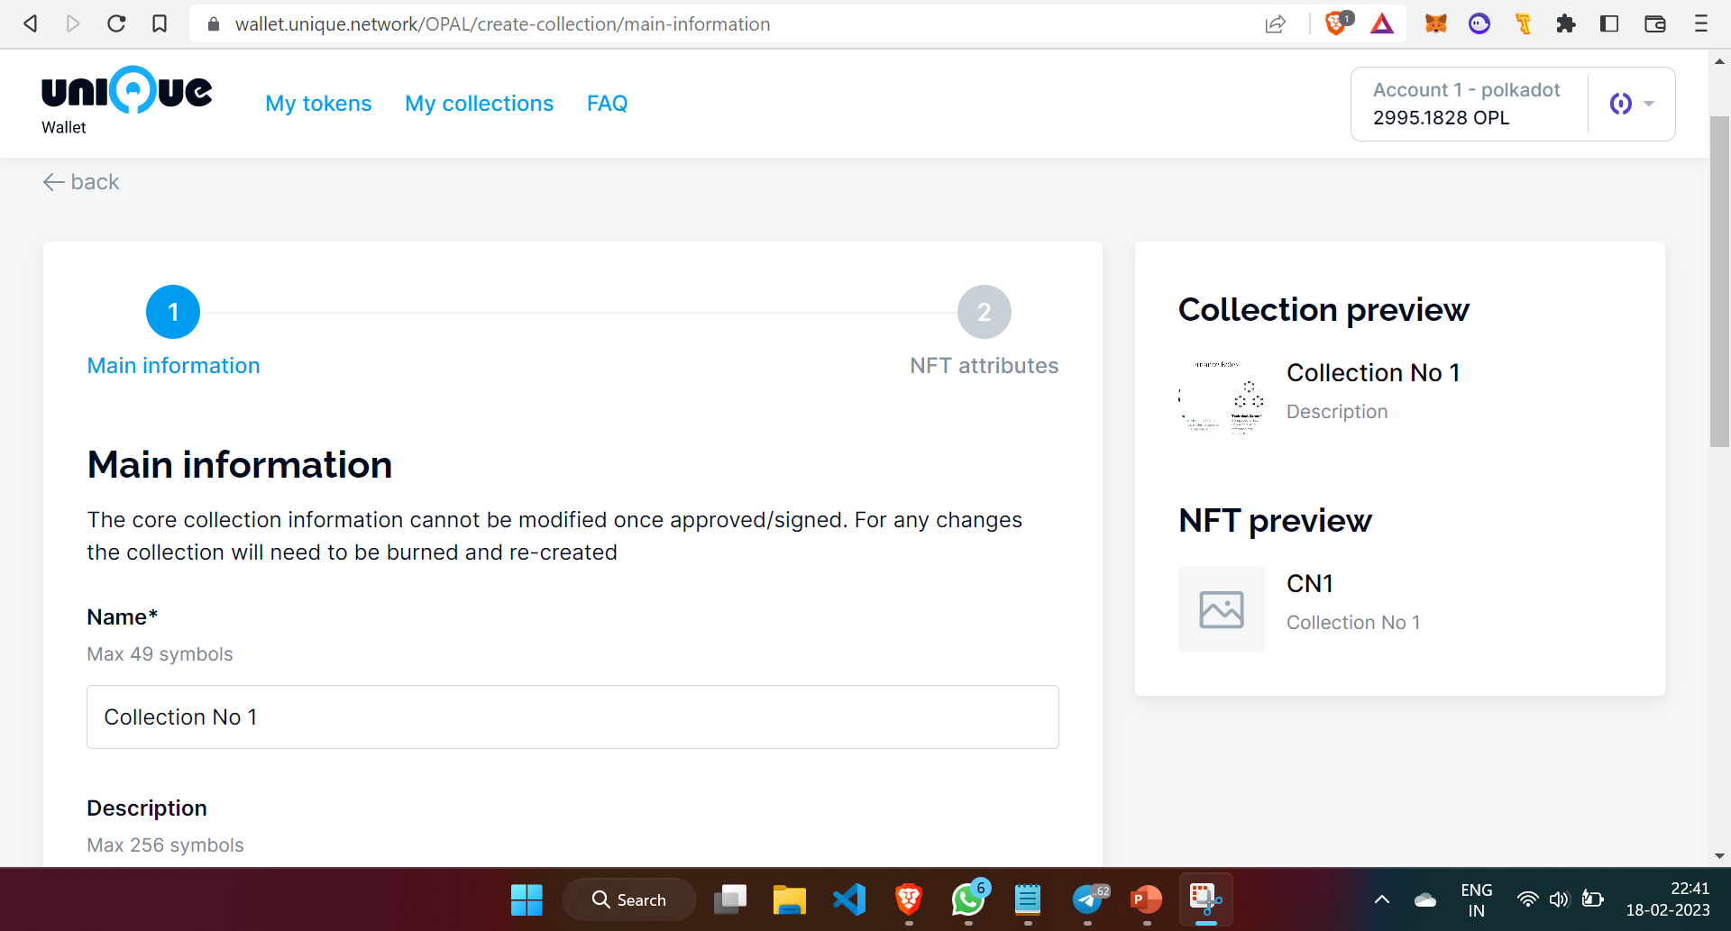
5. Creating Collection

Slide 7
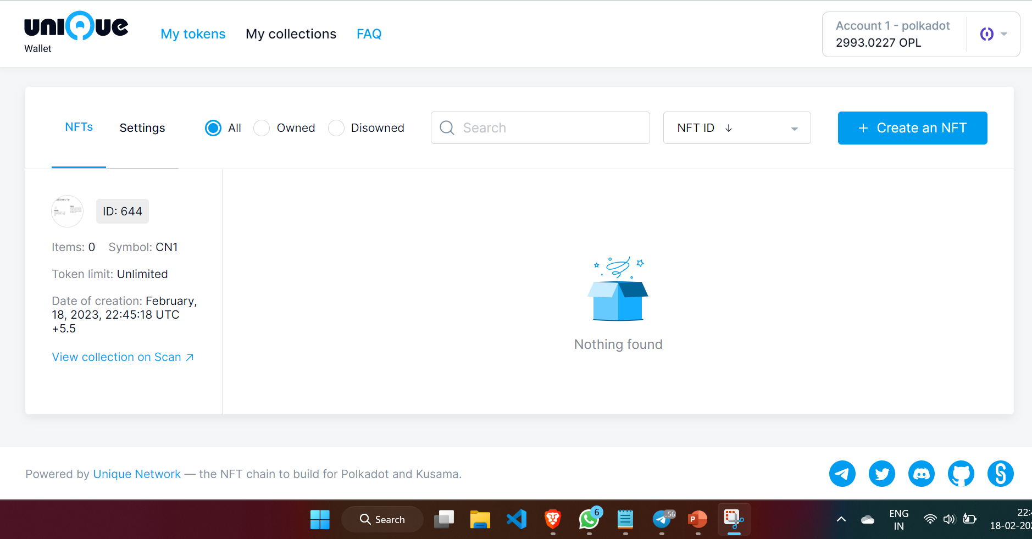
6. Collection created

Slide 8
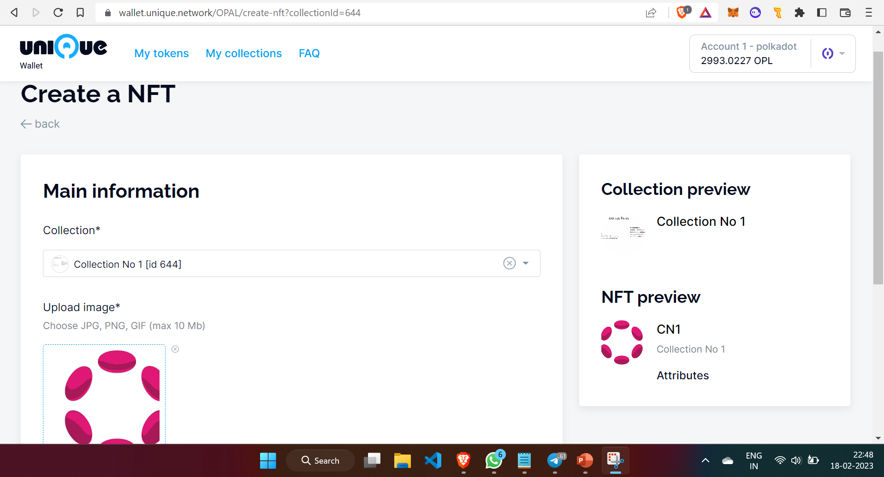
7. Creating NFT

Slide 9
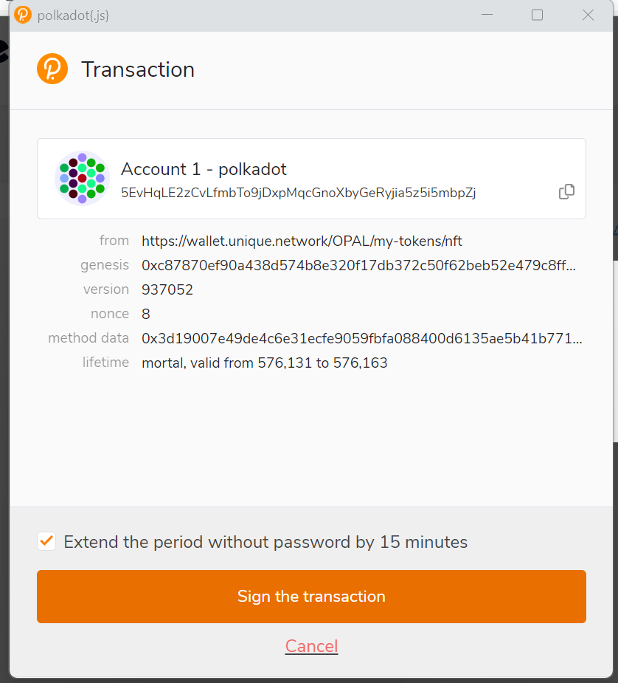
8. Signing the transaction

Slide 10
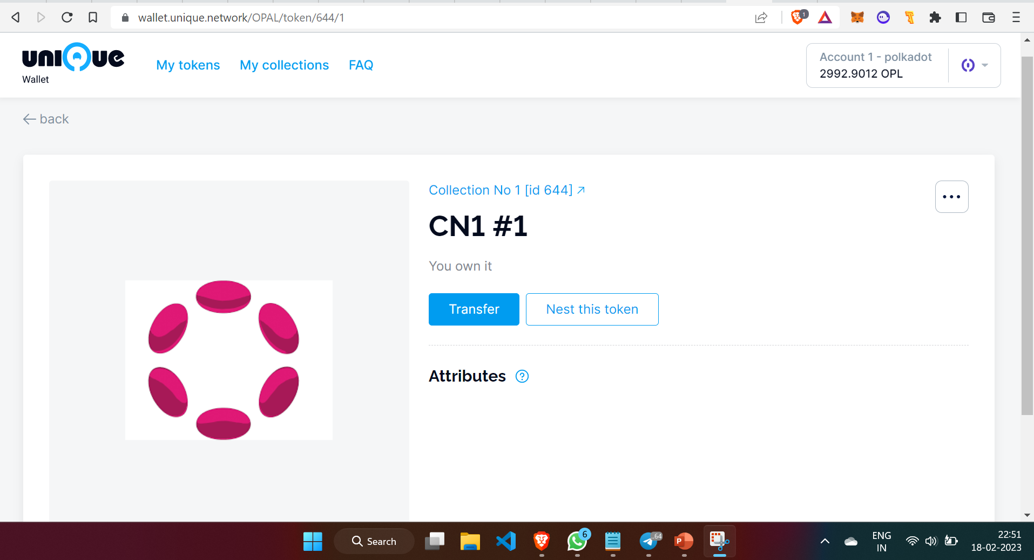
9. NFT Successfully minted using Unique Network Wallet

